Slide 1
Big Data Deletion Using Apache Iceberg and Airflow
- By Akshita Aggarwal, Software Engineer @ Pinterest, Dublin

Slide 2

What is Big Data?
Monthly Active Users
498M
Total Boards
1B
Total Pins
175B
Total searches/month
5B

Slide 3
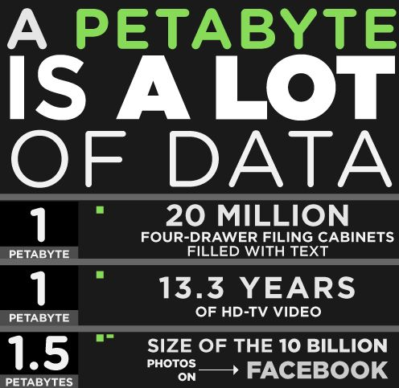
Is PETABYTE a lot of Data?

Slide 4
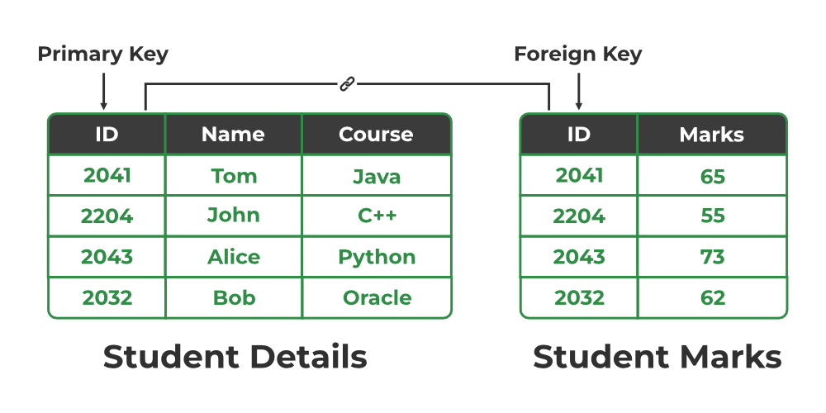
MySQL relational table vs Big Data Table
File 2
File 1

Slide 5
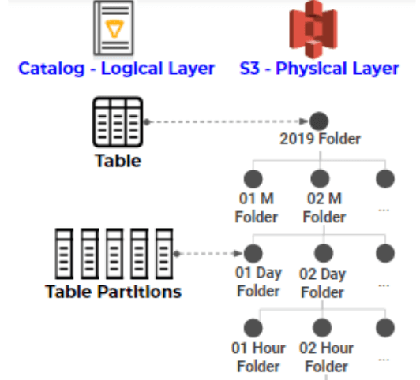
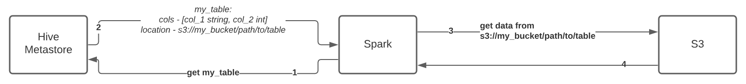
Big Data Hive Table in S3
s3:://my_bucket/path/year=2019/month=01/day=12

Slide 6
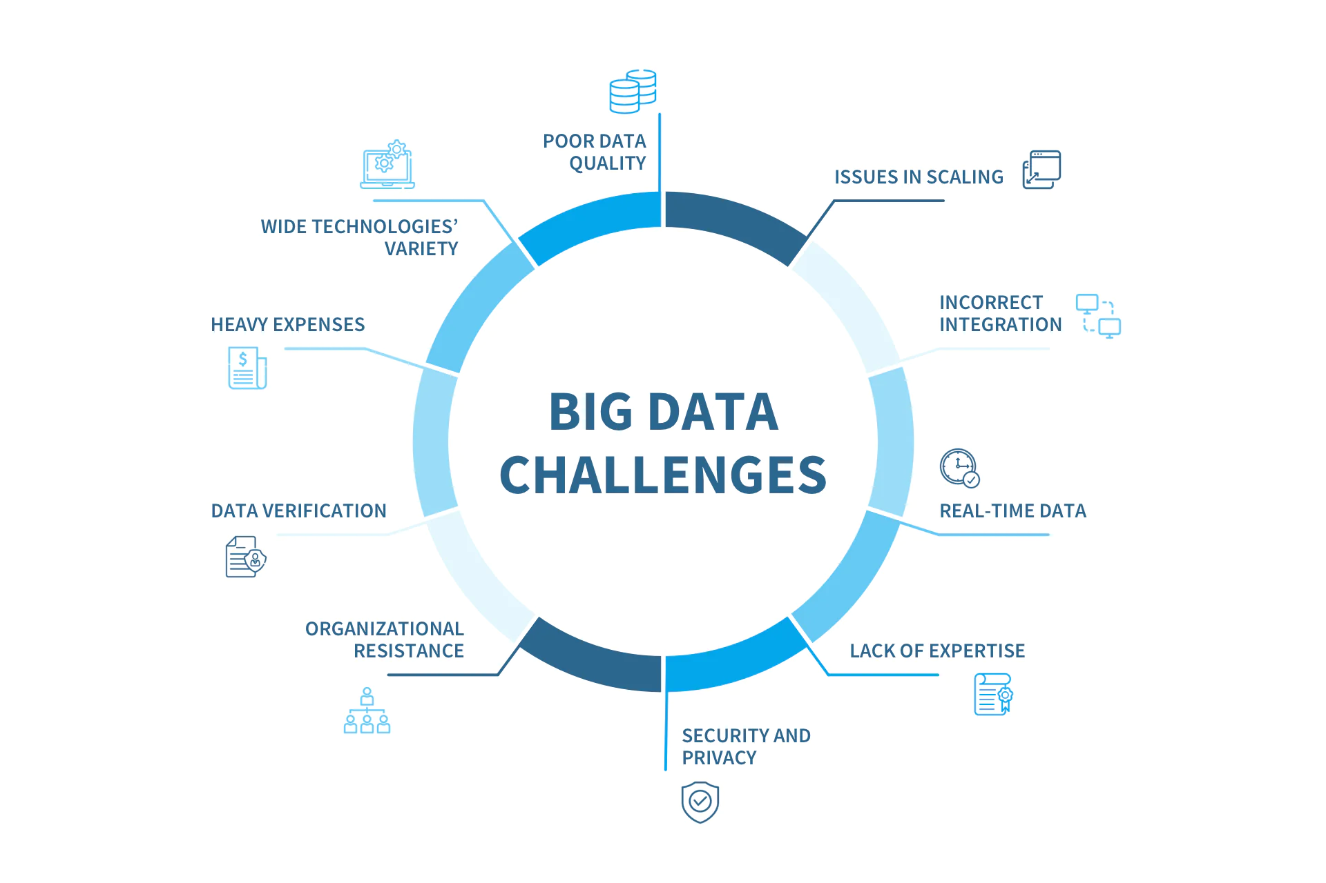
Why is dealing with Big data difficult?

Slide 7
Why Data Deletion in Big Datasets
Data Quality
Resource Optimization
Performance Enhancement
Regulatory Compliance
Business Agreements

Slide 8
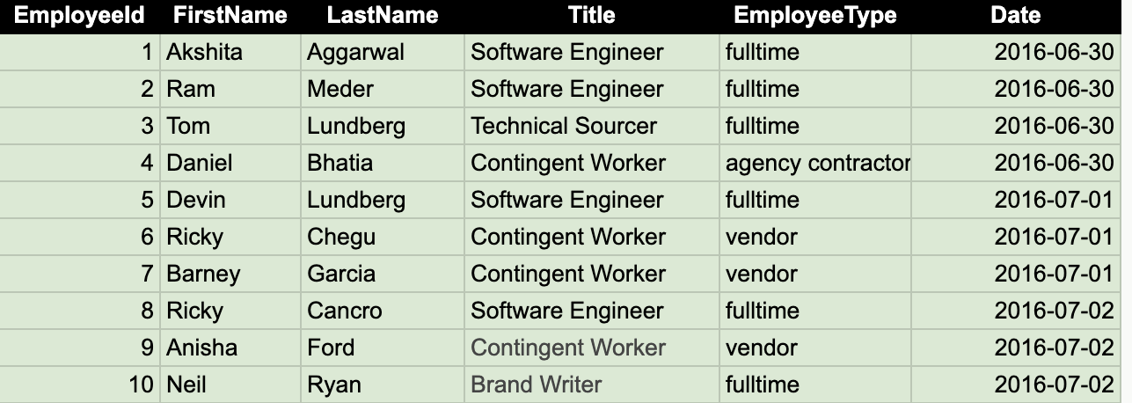
Let’s see how we will delete from below table?
dt=2016/06/30
dt=2016/07/01
dt=2016/07/02
F
F
F
F
F
F
F
F
F

Slide 9
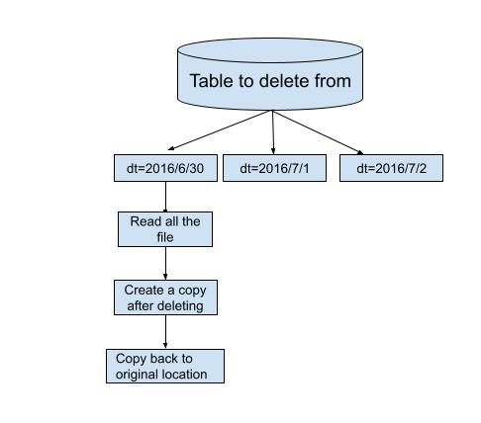
Why is Data Deletion hard?
Reads of entire partitions is expensive due to large volume of data
Large memory and I/0 operations due to copying data
Lack of isolation
‹#›

Slide 10

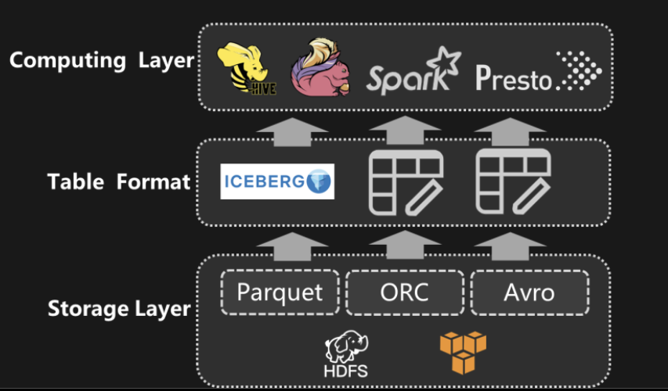
Apache Iceberg
An open-sourced table format for huge analytic datasets
Designed for huge, petabyte-scale tables.
Open sourced by Netflix
Used by companies: Pinterest, Apple, ByteDance, Tencent, Alibaba etc

Slide 11
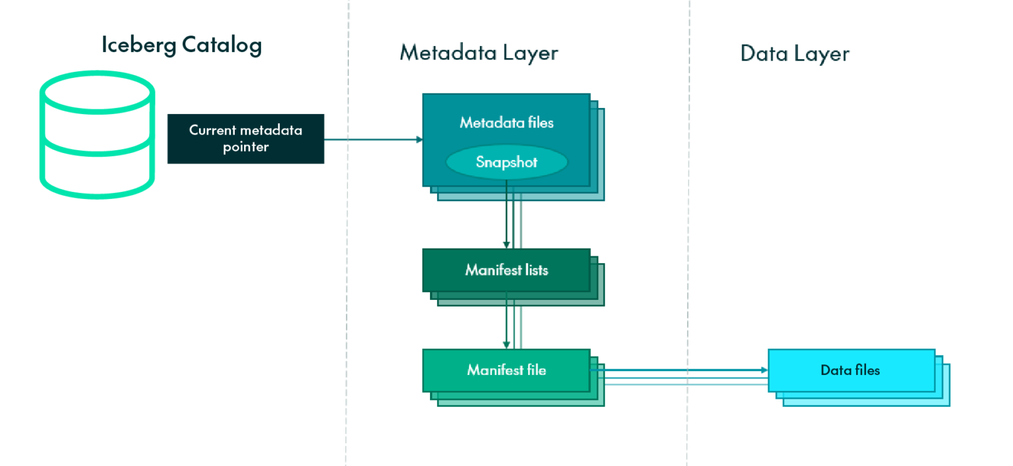
Iceberg Table Format
Chart source link

Slide 12
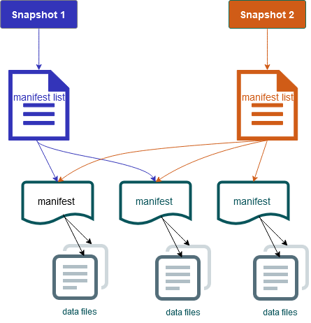
Apache Iceberg based data deletion
Delete employee Id E42 and E1000
Advantages of Iceberg
Snapshotting
Prevents inconsistent view of data
Indexing and Sorting
Only reads file that has data to be deleted
E1-100
E900-1000

Slide 13

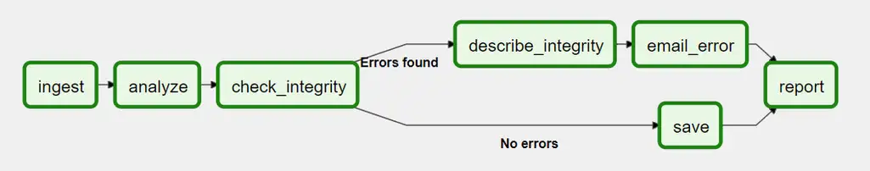
Running deletions on a schedule using Apache Airflow
Airflow™ is a platform created by the community to programmatically author, schedule and monitor workflows.
The tool represents processes in the form of directed acyclic graphs(DAGs).

Slide 14
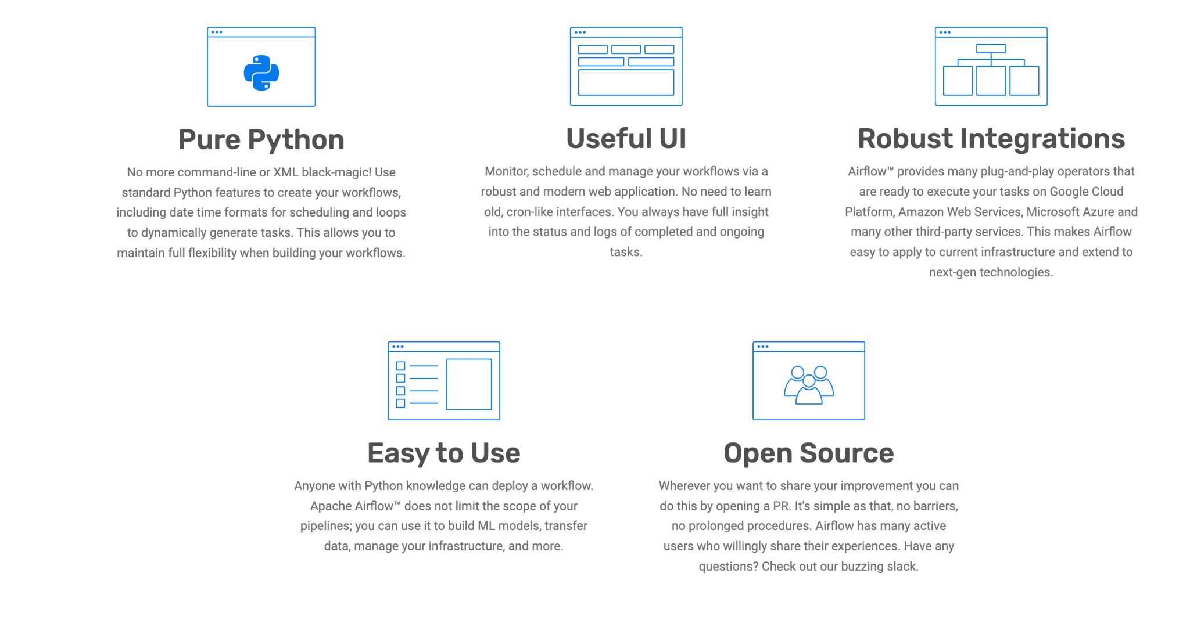
Features of Airflow

Slide 15
How does a deletion workflow look like?
dt=2016/06/30
dt=2016/06/30
Compute Layout
Sort Partition 1
Delete Partition 1
Create canary entries
Run canary tests
files rewrite job
Sort Partition 2
Deletion jobs
Delete Partition 2
Snapshot Updation
Sort Partition 3
Delete Partition 3
dt=2016/07/02
dt=2016/07/02

Slide 16
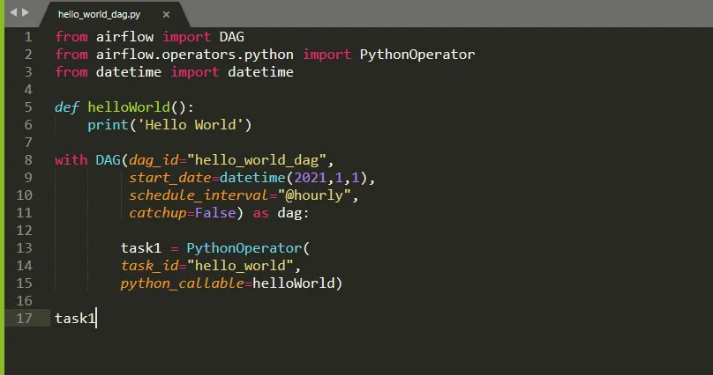
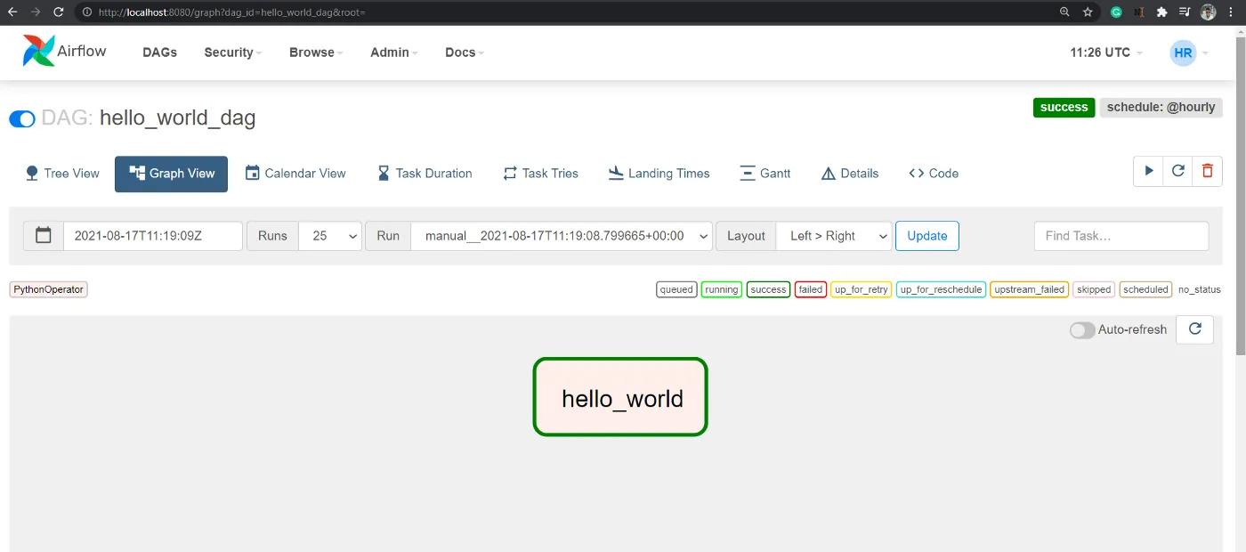
Static Dag in Airflow

Slide 17
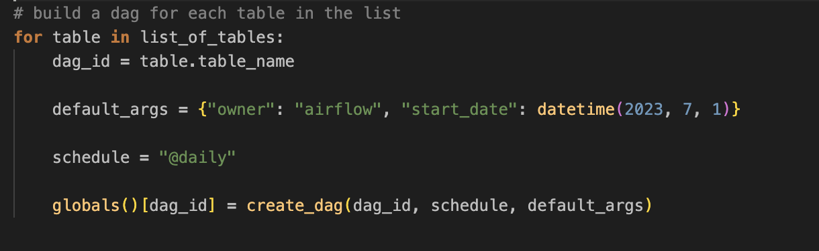
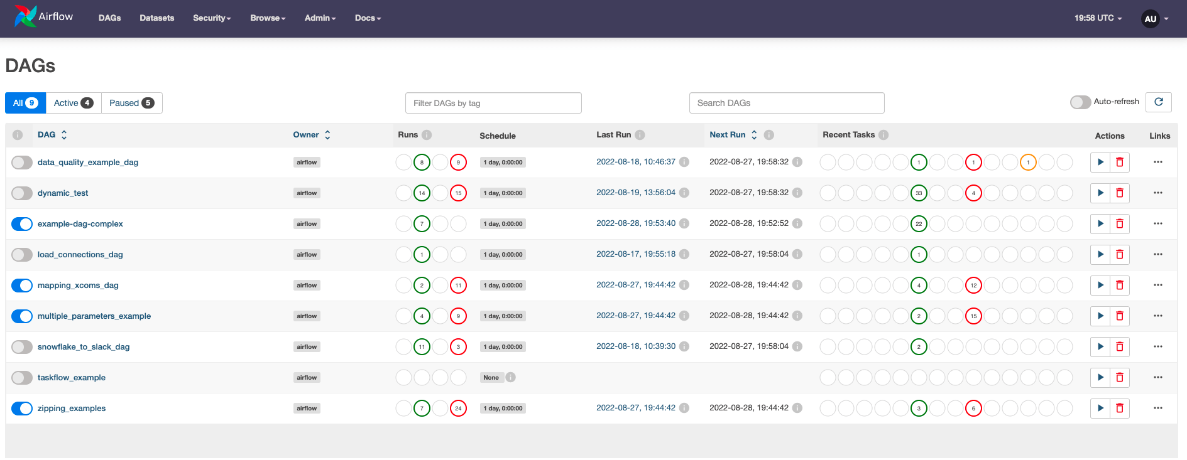
Dynamic Dag Generation at Scale

Slide 18
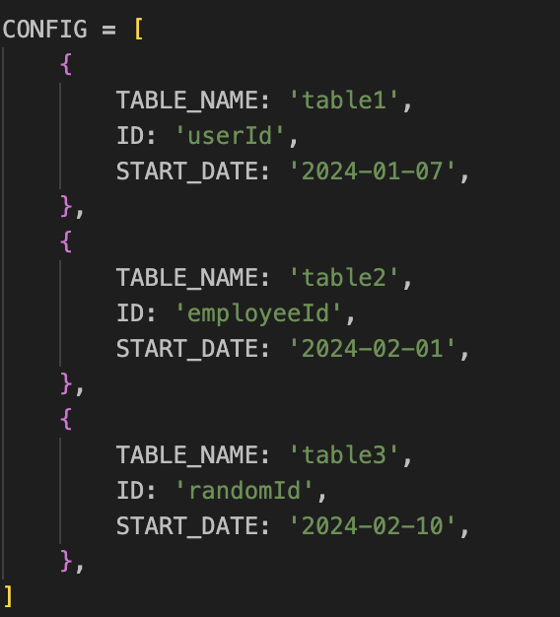
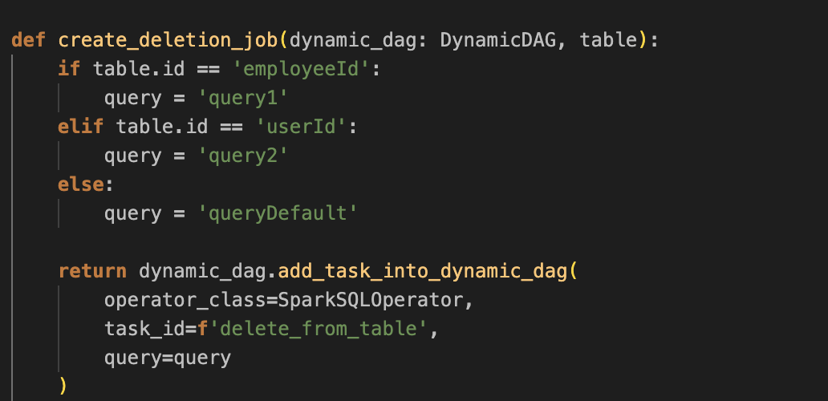
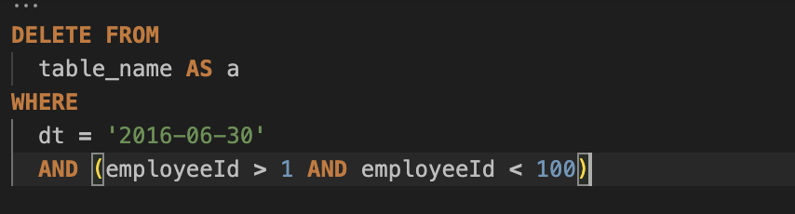
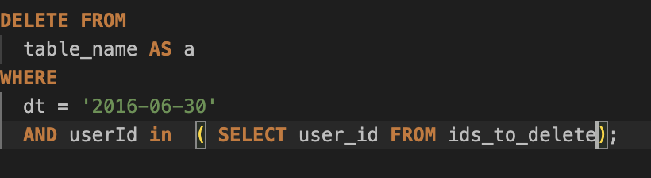
Process Customization and Config driven development

Slide 19
How we have evolved?
Customization
Pre-onboarding testing
Load balancing across the cluster
Supporting User specific logics for deletion
Monitoring Dag

Slide 20
Materials
Apache Iceberg: https://iceberg.apache.org/
Apache Airflow: https://airflow.apache.org/
Iceberg architecture: https://www.dremio.com/resources/guide/apache-iceberg-an-architectural-look-under-the-covers/

Slide 21
© 2022 Pinterest. All rights reserved.
Thank you for your time

